Slide 1
Giacomo Cappon
Advanced Topics

Slide 2
Outline
Recap
Backend development (Firebase, Django, Conduit, Serverpod, NodeJS)
Deployment
Research at DEI (PRIN, Air quality, Diabetes, PBH)
IMPACT
Open points and future work

Slide 3

Recap
Lesson 1
Lesson 5
Lesson 8
Lesson 10
Collaborate and version code
Create a layout
Make simple API calls
Implement user authentication
Lesson 2/3
Lesson 6
Lesson 9
Lesson 11
Get familiar with Dart
Navigate between screens
Fetch wearable data
Persist user data
Lesson 4
Lesson 7
Lesson 12
Understand Flutter’s principles
Manage the app state
Advanced stuff
Milestone #1
Milestone #2
Milestone #3
Do something with your fantasy

Slide 4


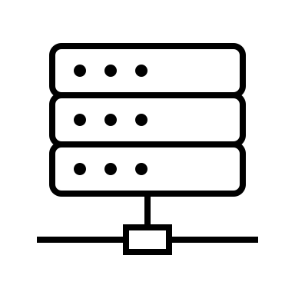



The network flow
Front-End
Back-End
DB
RESTful API
Messaging service
Server
Heavy computing service

Slide 5
Backend possibilities
Define APIs
Develop a custom messaging service
Cloud storage
Deploy heavy computing services
RESTful API
Heavy computing service
Messaging service
DB
Server
Notes:
We focused the laboratories on front-end development

Slide 6


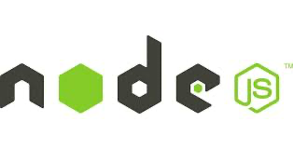
Backend - How to develop one?
The answer again is: do not reinvent the wheel, use something already developed.
There are a lot of solutions (each based on a different programming language), you just have to choose what’s the best for your needs and requirements.
Here’s some of the most popular backend frameworks:
Django: Python
Conduit: Dart
Node.js: Javascript
…
Notes:
We focused the laboratories on front-end development

Slide 7
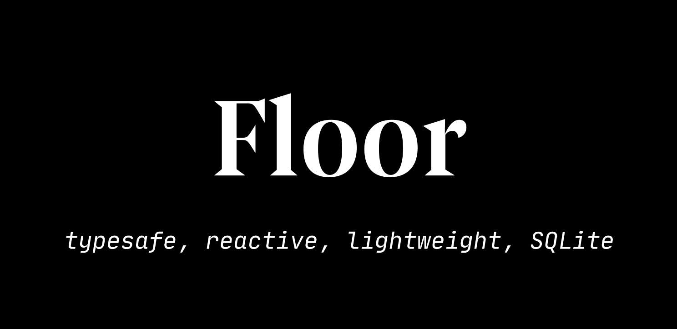
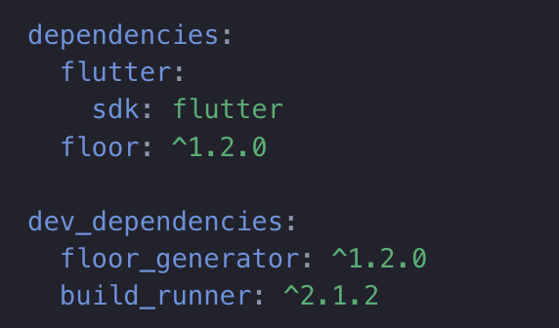
Floor
Fortunately, there exist several packages that make our life easier when dealing with DB in Flutter.
In this course, we will use Floor: a great package that automatically maps classes to database tables and offers full control of the database with the use of SQL:
https://floor.codes/
As such, it will be possible to define a table structure via a Dart class and make queries via Dart methods.
Big plus → Floor use the code generation concept: you define the specifics of your queries and DB structure, and Floor will generate the boilerplate code for you!

Slide 8
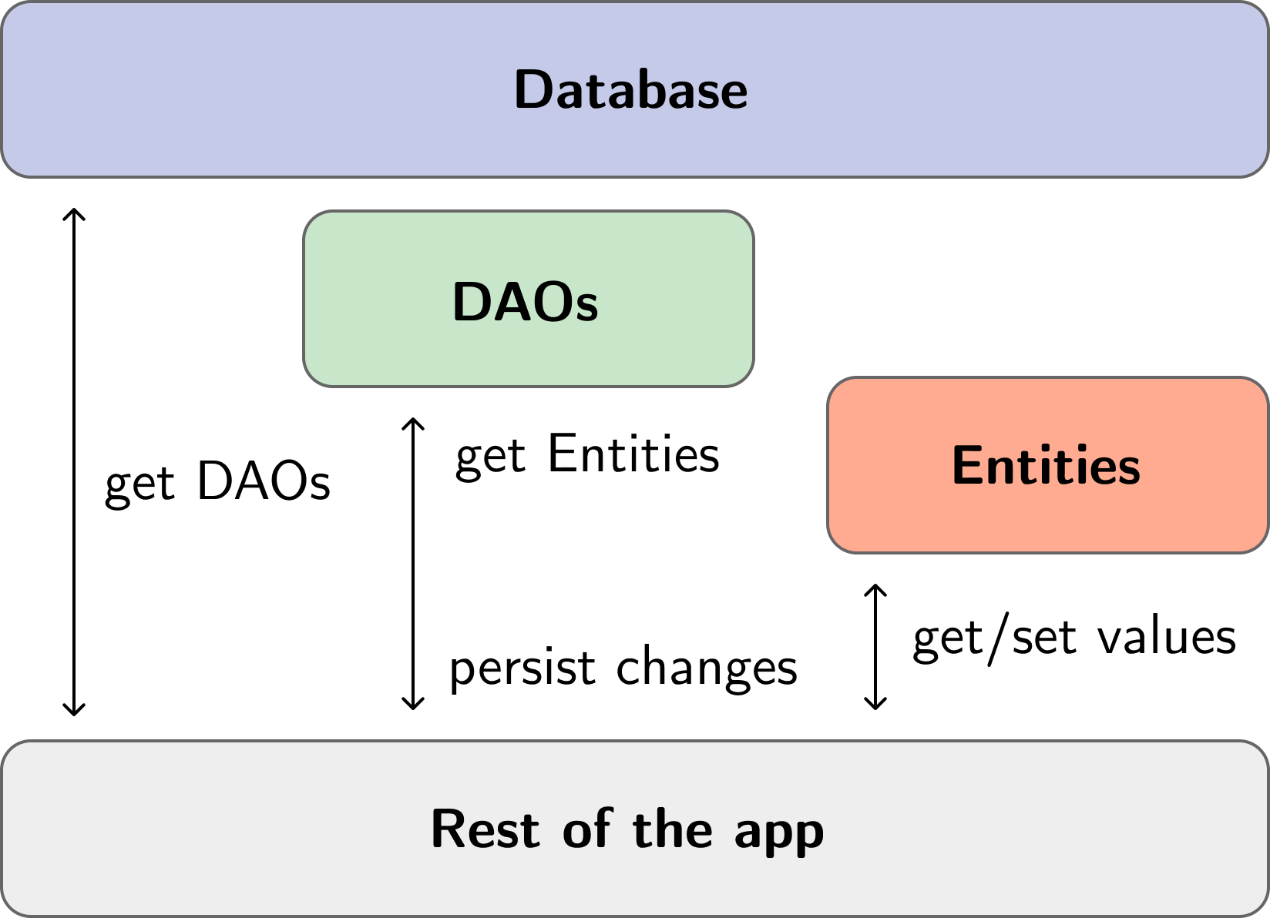
Overall architecture

Slide 9
Entity
An Entity defines the model of a table in the DB. Floor automatically creates the mappings between the in-memory objects and DB table rows.
It's possible to supply custom metadata to Floor by adding optional values to the @Entity annotation.
It has the additional attribute of tableName which opens up the possibility to use a custom name for that specific entity instead of using the class name.
@PrimaryKey marks the primary key column. This property has to be of type int. The value can be automatically generated by SQLite when autoGenerate : true.
If you want a table's column to be nullable, mark the entity's field as nullable with ?.
@Entity(tableName: 'person')
class Person {
@PrimaryKey(autoGenerate: true)
final int id;
final String name;
Person(this.id, this.name);
}

Slide 10
Entity - Supported types and Primary Keys
Floor entities can hold values of the following Dart types mapped to their corresponding SQLite types.
In case you want to store sophisticated Dart objects you have to define a TypeConverter (see exercise 11.01 solution to see how).
If you need to define a compound primary key (e.g., many-to-many relationship), you can use again the @Entity annotation
Dart | SQLite
int | INTEGER
double | FLOAT
String | TEXT
bool | INTEGER (0 = false, 1 = true)
Uint8List | BLOB
@Entity(primaryKeys: ['id', 'name'])
class Person {
final int id;
final String name;
Person(this.id, this.name);
}

Slide 11
Entity - Foreign Keys
To define a foreign keys, add a list of ForeignKeys to the @Entity annotation of the referencing entity.
childColumns define the columns of the current entity, whereas parentColumns define the columns of the parent entity.
Foreign key actions can get triggered after defining them for the onUpdate and onDelete properties.
@Entity(
tableName: 'dog',
foreignKeys: [
ForeignKey(
childColumns: ['owner_id'],
parentColumns: ['id'],
entity: Person,
)
],
)
class Dog {
@PrimaryKey()
final int id;
final String name;
@ColumnInfo(name: 'owner_id')
final int ownerId;
Dog(this.id, this.name, this.ownerId);
}

Slide 12
DAO
These components are responsible for managing access to the underlying SQLite database and are defined as abstract classes with method signatures and query statements.
From the practical point-of-view, in the DAO, you will define all the queries you want to be able to execute
@dao
abstract class PersonDao {
@Query('SELECT * FROM Person')
Future<List<Person>> findAllPersons();
@Query('SELECT * FROM Person WHERE id = : id')
Stream<Person?> findPersonById(int id);
@insert
Future<void> insertPerson(Person person);
}

Slide 13
DAO - Insert
@insert marks a method as an insertion method.
When using the capitalized @Insert you can specify a conflict strategy. Else it just defaults to aborting the insert.
These methods can return a Future of either
void: return nothing
int: return primary key of inserted item
List<int>: return primary keys of inserted items
Examples:
@Insert(onConflict: OnConflictStrategy.rollback)
Future<void> insertPerson(Person person);
@insert
Future<List<int>> insertPersons(List<Person> persons);

Slide 14
DAO - Update
@update marks a method as an update method.
When using the capitalized @Update you can specify a conflict strategy. Else it just defaults to aborting the update.
These methods can return a Future of:
void: return nothing
int: return number of changed rows
Examples:
@Update(onConflict: OnConflictStrategy.replace)
Future<void> updatePerson(Person person);
@update
Future<int> updatePersons(List<Person> persons);

Slide 15
DAO - Delete
@delete marks a method as a deletion method.
These methods can return a Future of:
void: return nothing
int: return number of deleted rows
Examples:
@delete
Future<void> deletePerson(Person person);
@delete
Future<int> deletePersons(List<Person> persons);

Slide 16
Database
To create a Database, define an abstract class which extends FloorDatabase.
Furthermore, it's required to add @Database() to the signature of the class.
Make sure to add the created entity to the entities attribute of the @Database annotation.
In order to make the generated code work, it's required to also add the highlighted imports in the example.
Make sure to add part 'database.g.dart'; beneath the imports of this file. It's important to note that 'database' has to get exchanged with the filename of the database definition. In this case, the file is named database.dart.
// required package imports
import 'dart:async';
import 'package:floor/floor.dart';
import 'package:sqflite/sqflite.dart' as sqflite;
import 'dao/person_dao.dart';
import 'entity/person.dart';
part 'database.g.dart'; // the generated code will be there
@Database(version: 1, entities: [Person])
abstract class AppDatabase extends FloorDatabase {
PersonDao get personDao;
}

Slide 17
Outline
Recap
The Floor package
Code generation
Case study and how to integrate a DB with Provider
Two tips for the project
Exercise
Homework
Resources

Slide 18
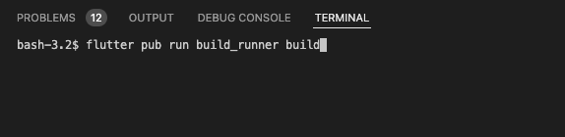
The final step: generating all the code
To generate the code simply open the terminal of VS Code and run flutter packages pub run build_runner build
Remember that every time you change something in the code of the entities, the daos, or the database, you need to rerun the command!

Slide 19
Use the generated code
For obtaining an instance of the database, use the generated $FloorAppDatabase class, which allows access to a database builder.
The name is composed by $Floor and the database class name.
The string passed to databaseBuilder() will be the database file name.
For initializing the database, call build() and make sure to await the result.
You need to do it at the beginning of your app.
//Example on how to init the DB
final AppDatabase database = await $FloorAppDatabase.databaseBuilder('app_database.db').build();
//Example on the use
final personDao = database.personDao;
final person = Person(1, 'Frank');
await personDao.insertPerson(person);
final result = await personDao.findPersonById(1);

Slide 20
Outline
Recap
The Floor package
Code generation
Case study and how to integrate a DB with Provider
Two tips for the project
Exercise
Homework
Resources

Slide 21
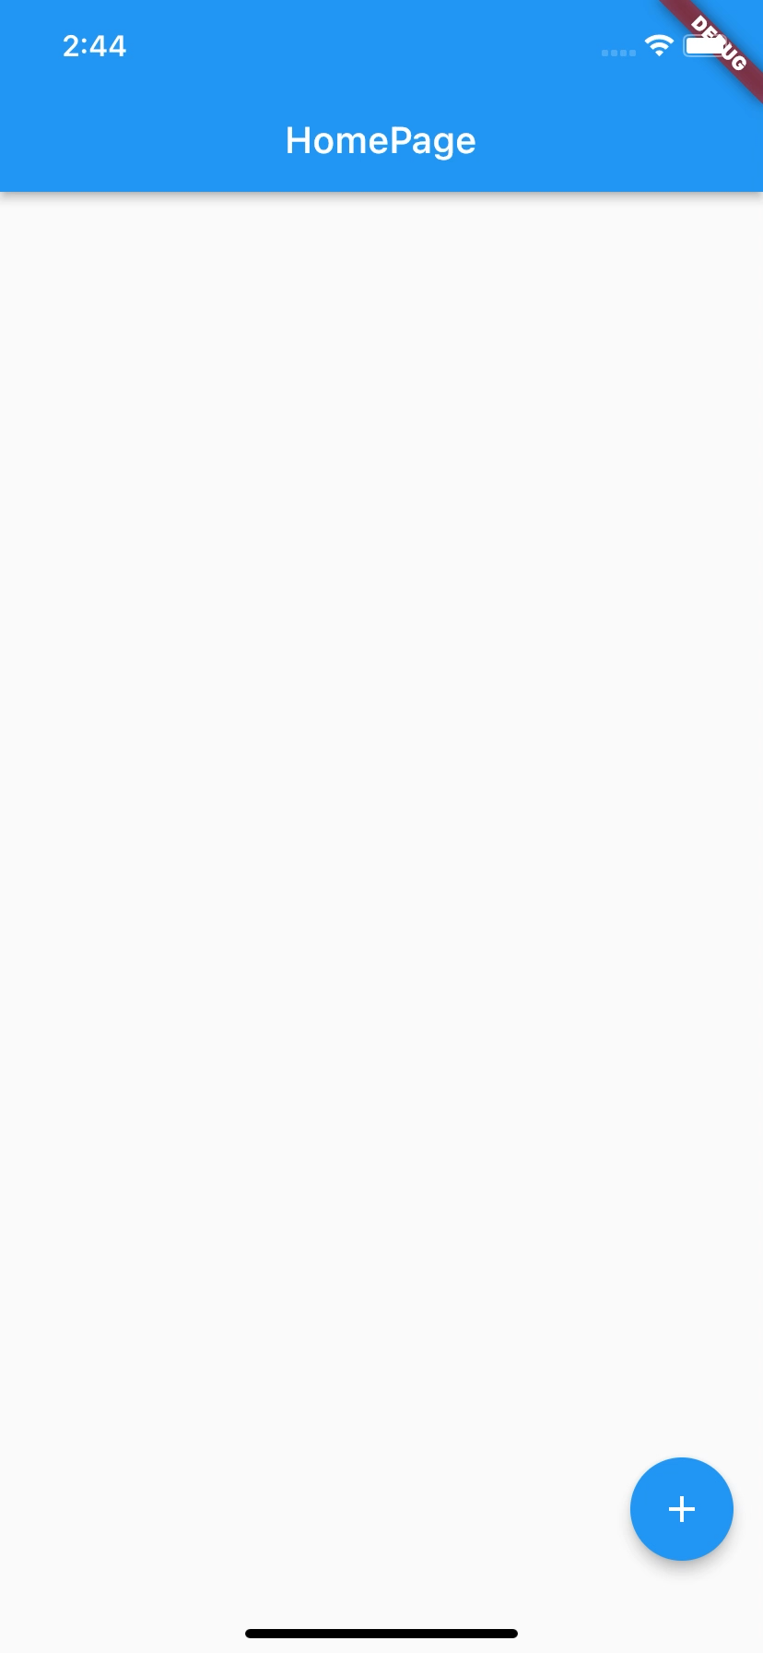
Case of study
As simple use case, let’s implement a very simple DB and a “TODO” simple app called ‘busy_day’.
The database will consist of only 1 table: Todo
The app will consist of a simple ListView that visualizes, inserts and deletes the entries of the Todo table. So we have to “implement” the following three queries:
SELECT to obtain all the Todos in the table;
DELETE to remove a Todo from the table;
INSERT to create a Todo and put it in the table.

Slide 22
Case of study – State management with Provider
ChangeNotifierProvider that provides the Repository to the app widget tree
How to “integrate” the DB in the business logic of an app using providers?
We will take inspiration from the repository design pattern.
What happens now if, for example, you have a ListView, that visualizes the entry of a table, and somebody deletes something from that table?
Class (Repository) that wraps DAO methods and extends ChangeNotifier
Consumer of the Repository (this allows to access to the DB and rebuilds if something in the DB changes)
DAO
Widget using the methods of the Repository
UI Widget showing the data
…
DB
Full example in lab_11-persistence_part_2/busy_day/
Notes:
Step 0: install dependencies
Step 1: Define the tables
Step 2: Define the daos
Step 3: Define the DB and generate code running flutter pub run build_runner build
Step 4: Create the Repository, get an instance of the DB at the beginning of the app, create the repo instance and provide it to the app
Step 5: Create the UI and link everything

Slide 23
Outline
Recap
The Floor package
Code generation
Case study and how to integrate a DB with Provider
Two tips for the project
Exercise
Homework
Resources

Slide 24
Two tips for the project
During the project discussion it would be nice to see/discuss
The ER diagram of the database
How you decided to manage your data in terms of regulatory aspects

Slide 25
Outline
Recap
The Floor package
Code generation
Case study and how to integrate a DB with Provider
Two tips for the project
Exercise
Homework
Resources

Slide 26

Exercise
Exercise 11.01
Start from the code of exercise 07.01.
Use Floor to define a proper entity, DAO, and DB to persist the meal data.
Note that Floor does not support natively the DateTime type. As such, to define the entity of the meal you must use a TypeConverter. Try to follow the docs to implement it:
https://floor.codes/type-converters/
If you are not able to solve the “TypeConverter issue”, you can find the solution in the lab repository. Particularly, look at lib/database/typeConverters/dateTimeConverter.dart and lib/database/database.dart files.

Slide 27
Outline
Recap
The Floor package
Code generation
Case study and how to integrate a DB with Provider
Two tips for the project
Exercise
Homework
Resources

Slide 28
Homework
Get familiar with Floor by taking a look at the docs
Try to integrate Floor in your project. Here’s a possible roadmap to follow:
Start by defining (on paper) a simple DB made of 1 table able to store 1 ”type” of data fetched from fitbitter, e.g., step counts.
Create the entity that implement the table you designed
Create the DAO for that entity. Again, I suggest to start easy: define just 3 queries: one for reading all the entries of the table (SELECT), one for inserting entries (INSERT), and one for deleting entries (DELETE)
Create the DB and generate the code.
Create the repository that wraps the DAO and extend ChangeNotifier
Initialize the DB at the beginning of your code and provide the repository to the app.
Try to use the DB.
Go back to step 1 and add the other tables according to your needs.

Slide 29
Outline
Recap
The Floor package
Code generation
Case study and how to integrate a DB with Provider
Two tips for the project
Exercise
Homework
Resources

Slide 30
Resources
Floor official docs
https://floor.codes/
Repository design pattern
https://medium.com/@pererikbergman/repository-design-pattern-e28c0f3e4a30

